Slide 1
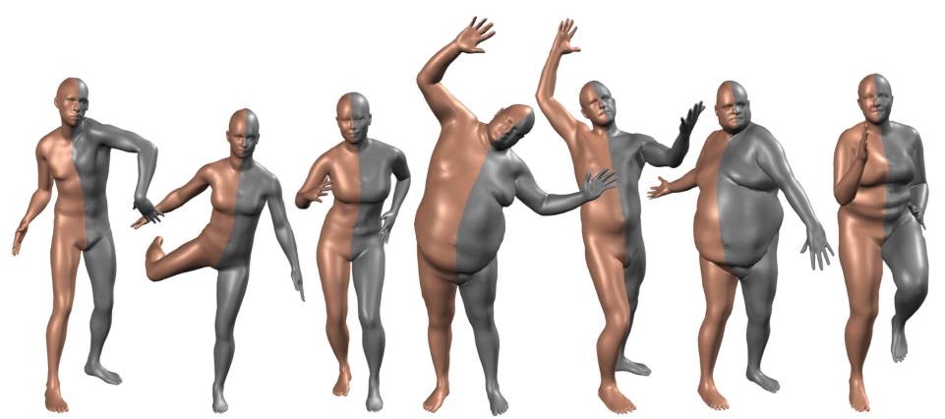
SMPL: A Skinned Multi-Person Linear Model
Thai Thanh Tuan, YoungSik Yun
Create: 6th July 2021

Slide 2
Introduction
Paper: https://files.is.tue.mpg.de/black/papers/SMPL2015.pdf
Project: https://smpl.is.tue.mpg.de/
Github: SMPL-X https://github.com/vchoutas/smplx/tree/master/transfer_model

Slide 3
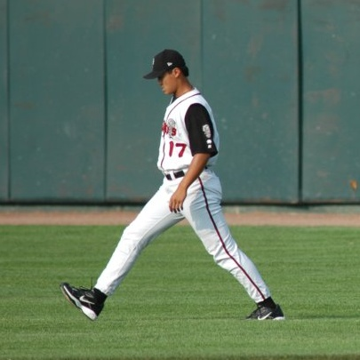
Introduction
3D body Dataset
+How to store and visualize?
→ SMPL model
Body and shape parameters
Optimization based:
+SMPlify
+SMPLifyX
Deep learning:
+HMR
+SPIN
+Graph CNN based

Slide 4
Store 3D data
3D vertices coordinate:
+large memory
+not easy to change shape and pose
SMPL model
+Less memory
+Easy to change shape and pose
+Naturally/Realistic deform
Notes:
사람마다 다른 체형을 고려하여 natural한 pose를 가진 3D human mesh를 생성

Slide 5
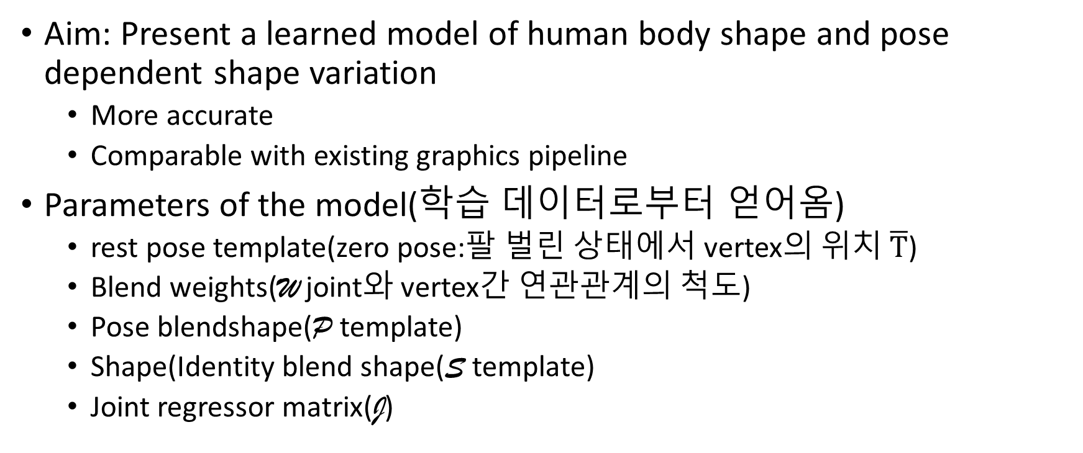
Introduction
Aim: Present a learned model of human body shape and pose dependent shape variation
More accurate
Comparable with existing graphics pipeline
Parameters of the model(학습 데이터로부터 얻어옴)
rest pose template(zero pose:팔 벌린 상태에서 vertex의 위치 $\overline{T}$)
Blend weights(W joint와 vertex간 연관관계의 척도)
Pose blendshape(P template)
Shape(Identity blend shape(S template)
Joint regressor matrix(J)
Notes:
이전의 연구와 호환이 되도록

Slide 6
People deform with pose
Low-polygon count
Simple vertex topology
Clean quad structure
Standard rig
Reasonable hand and face detail
Template mesh
Blend weights
Align
optimize
Pose-dependent blend shapes
1786 high resolutions 3D scan:
+diff subjects
+wide variety of poses
Training set
(aligned scans)
Mean template shape (rest pose)
Joints = Regressor(shape)

Slide 7
Linear models of male and female body shape
CAESAR dataset [Robinette et al. 2002]
~2000 scans / gender
Template mesh
Body blend shapes:
300 principal components
(using only 10)
Scans
(CAESAR)
Register
Pose normalize
Principal Component analysis (PCA)

Slide 8
Related work: Blend skinning
Skeleton subspace deformation methods
Attach the surface of a mesh to an underlying skeletal structure
Unnatural results
Vertex
(on mesh surface)
transform
Transformed vertex
Weighted (from neighboring bones)

Slide 9
Related work: Auto rigging
joints
Collection of meshes
Infer
bones
Blend weights

Slide 10
Model formulation
Mesh N = 6890 Vertices
K = 23 joints
A segmentation into parts
Initial blend weights
Skeletal rig

Slide 11


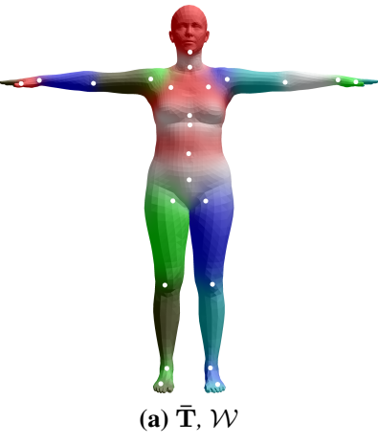

Mean template shape
Zero pose:
Blend weights:

Slide 12

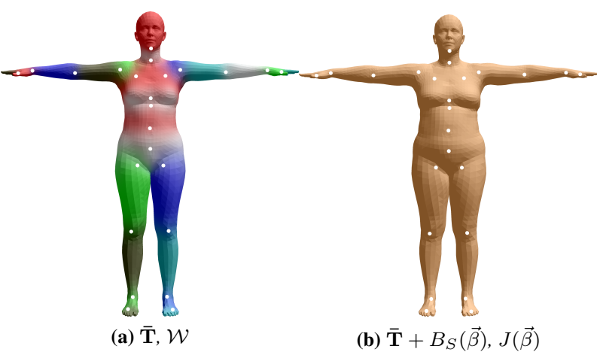

A blend shape function:
Shape parameters:
Output: blend shape sculpting the subject identity
Function to predict K = 23 joint locations: white dots

Slide 13

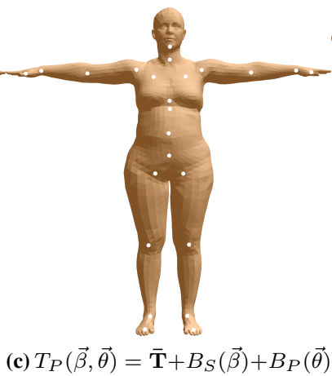
Pose-dependent blend shape function:
Pose parameters:

Slide 14

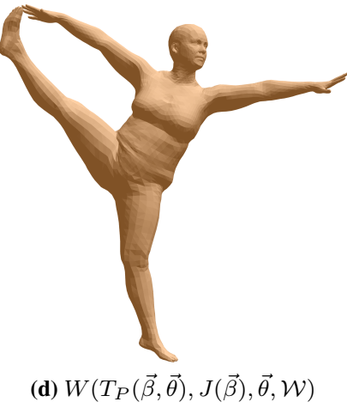

Standard blend skinning function (LBS or DQBS)
Rotate the vertices around the estimated joint centers with smoothing
Result:
Learned model parameters

Slide 15
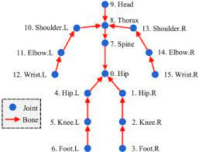



Blend skinning
Particular vertex:
Axis-angle between part k to its parents in the kinematic tree:
K = 23 joints →
Unit norm axis of rotation:
Each joint j → Rodrigues formula

Slide 16
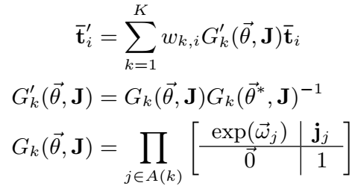


Blend skinning
Standard linear blend skinning function
Rest pose:
Joint locations: J
A pose:
Blend weights:
Return: The posed vertices
Each vertex in T →transformed

Slide 17



Blend skinning
Element of blend weight matrix
How much the rotation of part k effect vertex i
3x3 rotation matrix corresponding to join j.
World transformation of joints k:
→remove transformation of rest pose :
Joints j location:
Ordered set of joint ancestors of join k:

Slide 18

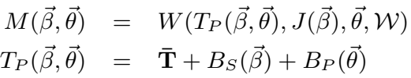



Blend skinning
SMPL blend skinning model:
Vectors of vertices representing offsets from the template.
Shape blend shape
Pose blend shape:
Then:
Explain in next slides

Slide 19
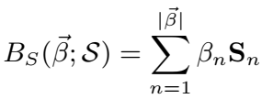



Shape blend shapes
Body shapes of different people represented by a linear function
Number of linear shape coefficients:
Orthonormal principal components of shape displacements:
S: learned from registered training meshes, Sec. 4

Slide 20






Pose blend shapes
Maps function:
Vector of concatenated part relative rotation matrices: : 23 x 9, non-linear with (functions of sines and cosines)
Matrix of all 207 pose blend shapes:
In rest pose, pose blend shapes is zero.
learned from registered training meshes, Sec. 4

Slide 21



Joint locations
Joints as a function of the body shape,
Matrix that transforms rest vertices into rest joints:
Models which mesh vertices are important
How to combine them to estimate the joint locations.

Slide 22



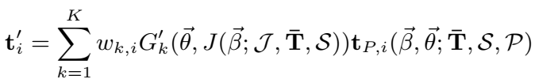


SMPL model
SMPL model:
How to lean these in Sec. 4
After learned, SMPL model:
Vertex transformed:
Vertex i after applying the blend shapes

Slide 23


4. Training
Aligned meshes: “registrations“
Multi-pose dataset:
1786 registrations of 40 individuals
891 of 20 females
895 of 20 males
Multi-shape dataset: registrations to the CAESAR dataset
1700 registration for males
2100 for females
jth mesh in multi-pose dataset: ; and in multi-shape dataset:
Minimize vertex reconstruction error

Slide 24


Training
Multi-pose dataset
Train
Multi-shape dataset
Train

Slide 25
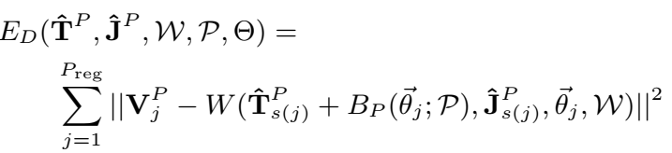








Pose parameter training
Compute rest template???
Multi-pose dataset
Compute joint location for each subject i
All rest poses
All rest joints
Number of meshes
Compute pose parameters for each registration j
Number of subjects

Slide 26
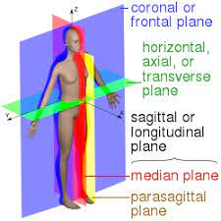

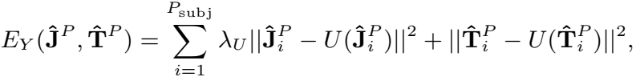


Pose parameter training
Regularization term:
Penalizes left-right asymmetry and
finds a mirror image of vertices T, by flipping across the sagittal plane
Encourages symmetric template meshes and joint locations.

Slide 27
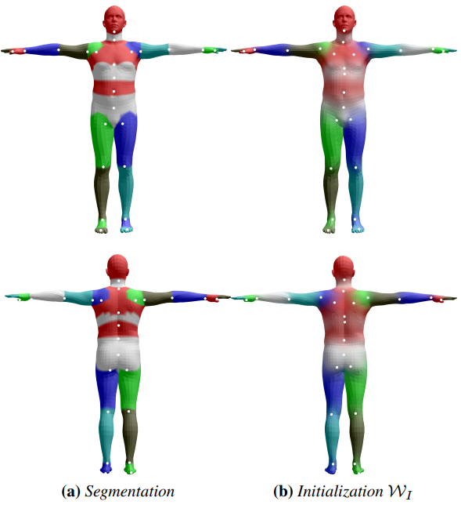


Initial estimate of the joint centers
Model is hand segmented into 24 parts.
average ring of vertices connecting two parts.
The estimating joints need to be close to the initial prediction

Slide 28

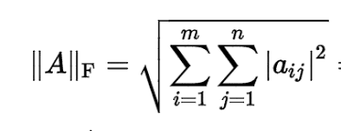

Regularization
Pose-dependent blend shapes towards zero:
Blend weights towards the initial weights
The initial weights are computed by simply diffusing the segmentation. -→ not simple for me

Slide 29

Training {W, P}

Slide 30
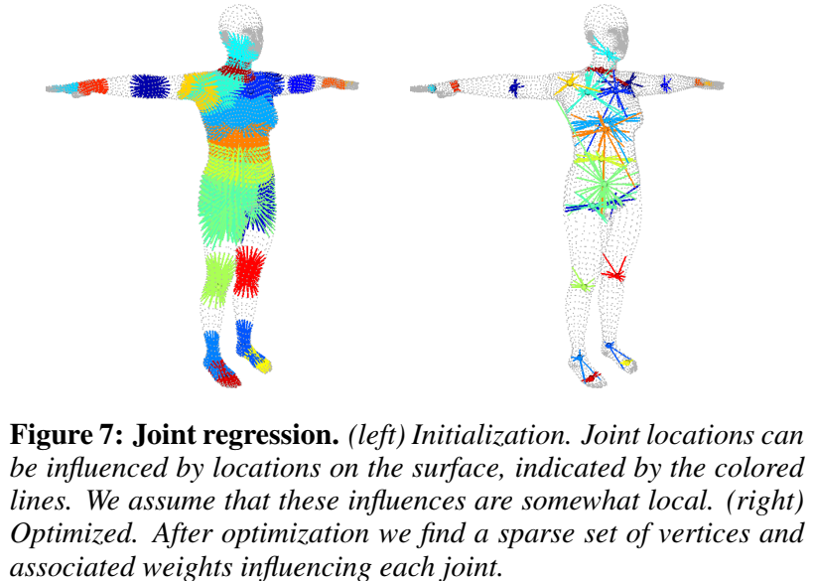
Joint regressor
Body mesh
Non –negative least square
[Lawson and Hanson 1995]???

Slide 31



Shape parameter training
: mean and principal shape directions
Multi-shape dataset
Pose normalized
PCA

Slide 32
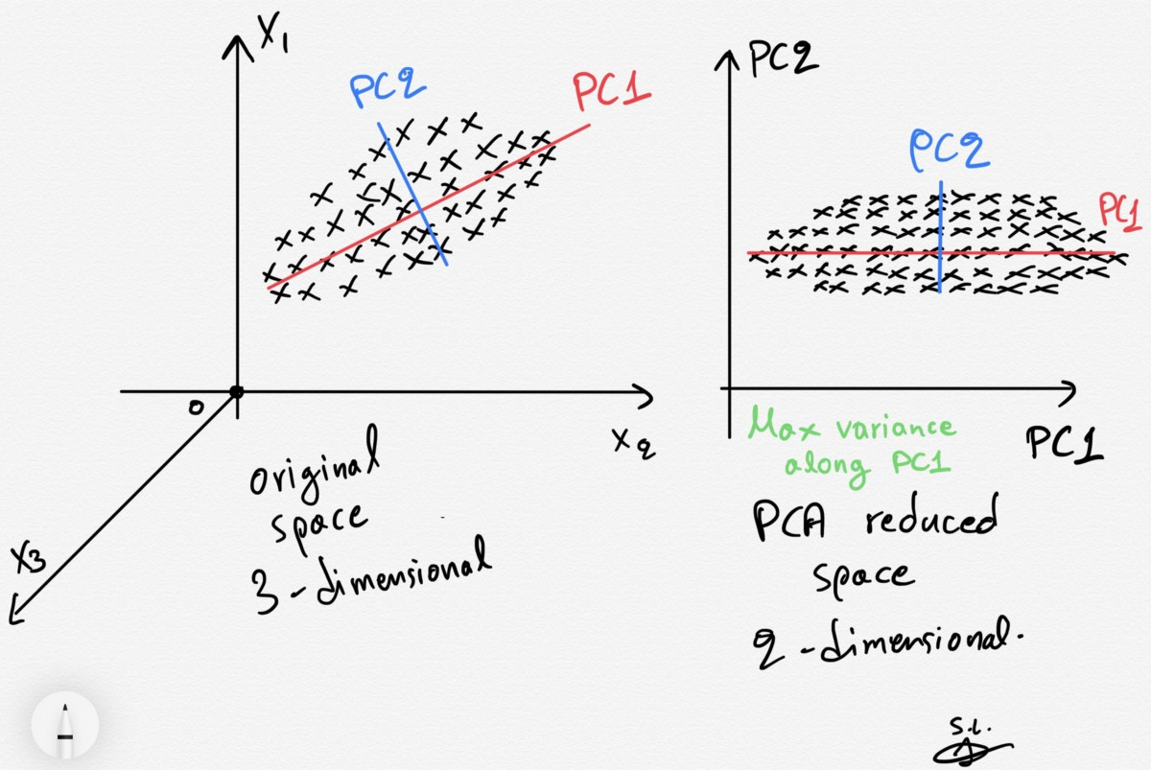
Principal component analysis (PCA)
Reduce dimensionality

Slide 33
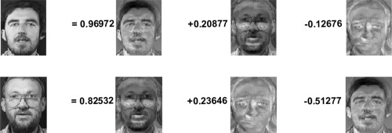
Application to face

Slide 34





From multi-pose dataset
Mean joint
locations
An edge of the model and the registration
Estimate pose blend shape
Find pose
Raw registration mesh
Find pose-normalized template
From multi-pose dataset

Slide 35
Evaluation

